Slide 1
Lecture 6 | Chapter 16
Speed of a Travelling Wave,
Wave Equation & Interference
Superposition · Constructive & Destructive Interference · Standing Waves
Applied Physics | BS Engineering | Chapter 16 – Waves

Slide 2
Learning Objectives
1. Derive and apply the wave speed equation v = fλ = λ/T
2. Understand wave speed on a string: v = √(F_T / μ)
3. Write and interpret the sinusoidal wave function y(x,t) = A sin(kx − ωt + φ)
4. Apply the principle of superposition to two or more overlapping waves
5. Distinguish constructive interference from destructive interference
6. Describe standing waves, nodes, antinodes, and resonance conditions
7. Solve Halliday-style problems involving all of the above

Slide 3
Section 1
Speed of a Travelling Wave

Slide 4
Wave Speed — Physical Derivation
Start from first principles:
1. In one period T, the wave crest moves forward by exactly one wavelength λ.
2. Speed = distance / time = λ / T
3. Since T = 1/f, substituting gives v = λ · f
Fundamental Wave Equation
Wave Speed on a String
v = f λ = λ / T
v = √( F_T / μ )
Applies to ALL wave types
F_T = tension (N), μ = linear density (kg/m)
Physical insight on string speed: Higher tension → stiffer string → wave travels faster. Higher linear density (heavier string) → wave travels slower.
Speed of sound in air at 20°C ≈ 343 m/s | Speed of light in vacuum = 3×10⁸ m/s

Slide 5
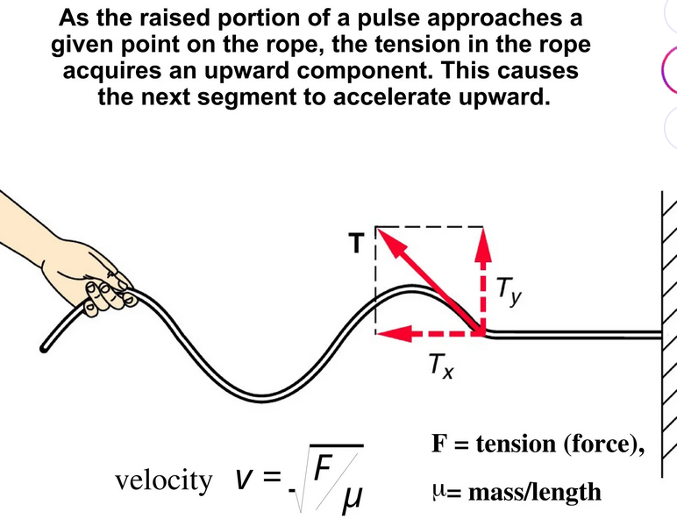
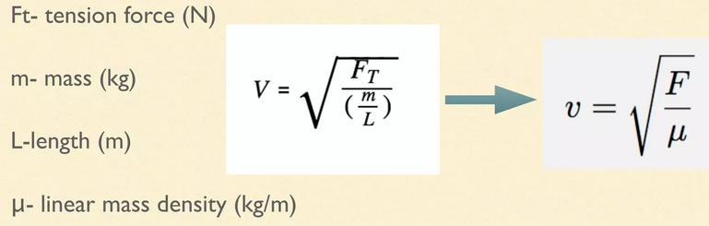
Wave Speed on a String: v = √(T/μ)
Physical understanding before the math
v = √( T / μ )
T (Tension) — NUMERATOR
μ (Linear Density) — DENOMINATOR
Higher tension → stronger restoring force → faster snap-back → wave propagates faster.
T ↑ → v ↑
Extreme: T → 0 (slack string) → v = 0
Higher mass density → more inertia → harder to accelerate → wave travels slower.
μ ↑ → v ↓
Extreme: μ → 0 (massless) → v = ∞
Changes v:
Tighten rope (T↑) · Use lighter rope (μ↓)
Does NOT change v:
Shake faster (f↑) · Shake harder (A↑) — MEDIUM controls speed!
If you shake faster:
f↑ · v unchanged · λ = v/f decreases (shorter waves)
Pattern:
v = √(elastic/inertial) — same form for ALL wave types in physics

Slide 6
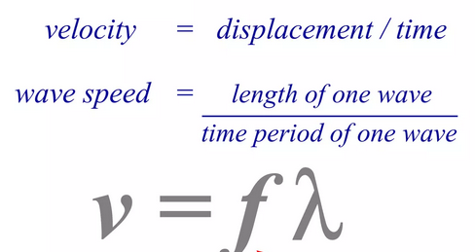
The Fundamental Speed Equation: v = fλ
Where it comes from and what it connects
SPEED
v = fλ = ω/k = λ/T
Logic: In one period T, one wavelength λ passes a fixed point. Speed = distance/time = λ/T = fλ.
SOURCE controls f
MEDIUM controls v
λ = v/f follows
The source (your hand shaking) sets the frequency. Shake faster → higher f. The medium doesn't change f.
v = √(T/μ). The string properties determine wave speed. Changing f or A does NOT change v.
Once source sets f and medium sets v, the wavelength has no choice: λ = v/f. It's a result, not a cause.
Example: guitar string — thinner string (μ↓) → v↑ → for same f, λ↑ (longer wavelength). Higher pitch = higher f, not higher v.

Slide 7
What Does a Particle Actually Do?
Wave speed vs particle speed — the most confused concept
Wave Speed v
Particle Speed uᵧ
Speed of the PATTERN moving along string
Speed of each particle moving up/down
Horizontal direction (along string)
Vertical direction (transverse)
CONSTANT — does not change with time
VARIES with time — it's sinusoidal
v = ω/k = fλ = √(T/μ)
uᵧ = −ωA cos(kx − ωt)
Does NOT depend on amplitude A or frequency f
Maximum: uᵧ,max = ωA
Particle Behavior Summary
Position
Displacement
Velocity
Acceleration
At Crest (y = +A)
+A
ZERO
Max downward
At Equilibrium (y = 0)
Zero
MAX = ωA
Zero
At Trough (y = −A)
−A
ZERO
Max upward

Slide 8
Worked Example — Guitar String Wave Speed
Problem (Halliday Example 16.5)
A guitar's high-E string has linear density μ = 3.09×10⁻⁴ kg/m and is under tension F_T = 56.40 N. (a) Find the wave speed on the string. (b) The low-E string has μ ≈ 20× greater. What tension is needed for the same wave speed?
Solution:
(a) High-E string speed
(b) Low-E tension needed
v = √(F_T / μ)
= √(56.40 / 3.09×10⁻⁴)
= √(182,524)
= 427.2 m/s
μ_low = 20μ_high
Same v → F_T = v² × μ_low
= (427.2)² × 20 × 3.09×10⁻⁴
≈ 1128 N

Slide 9
Section 2
The Sinusoidal Wave Equation

Slide 10
The Wave Function y(x, t) = A sin(kx − ωt + φ)
Physical meaning — what does each symbol represent?
y(x, t) = A sin( kx − ωt + φ )
A
Amplitude
k
Wave Number
Maximum displacement of medium from equilibrium (m)
k = 2π/λ (rad/m) — spatial frequency
ω
Angular Freq.
φ
Phase Shift
ω = 2πf = 2π/T (rad/s) — temporal frequency
Initial phase at t=0, x=0 (radians)

Slide 11
Wave Direction — Sign Convention
The sign of the time term tells you the wave's direction of travel:
→ Positive x-direction
← Negative x-direction
y(x,t) = A sin(kx − ωt)
y(x,t) = A sin(kx + ωt)
MINUS sign in time term.
As t increases, x must increase
to keep phase constant → moves right.
PLUS sign in time term.
As t increases, x must decrease
to keep phase constant → moves left.
Wave Speed
Wavelength
Period
v = ω / k
λ = 2π / k
T = 2π / ω

Slide 12
Phase — Where in the Cycle
Φ = kx − ωt + φ is the complete phase argument
Φ = kx − ωt + φ
Phase Φ
sin(Φ)
Position
Action
0
0
At center
Moving upward
π/2
+1
At peak
Turning around (momentarily stopped)
π
0
At center
Moving downward
3π/2
−1
At trough
Turning around (momentarily stopped)
2π
0
At center
Moving upward (full cycle complete)
Phase diff (space)
Phase diff (time)
ΔΦ = kΔx = (2π/λ)·Δx
ΔΦ = ωΔt = (2π/T)·Δt
Two points separated by Δx have phase difference kΔx. Full wavelength apart → ΔΦ = 2π (in phase again).
Same point, two different times. One full period apart → ΔΦ = 2π (back to same state).

Slide 13
Worked Example — Reading a Wave Function
Problem (Halliday Example 16.3)
A wave function: y(x,t) = 0.2 sin(6.28x − 1.57t) (SI units). Find: amplitude, wavelength, period, wave speed, and direction.
Amplitude
Wave Number
Wavelength
A = 0.2 m
k = 6.28 m⁻¹
λ = 2π/k = 2π/6.28 = 1.0 m
Read directly from equation
Compare to A sin(kx − ωt)
Angular Freq.
Period
Wave Speed
ω = 1.57 rad/s
T = 2π/ω = 2π/1.57 = 4.0 s
v = ω/k = 1.57/6.28 = 0.25 m/s
Read directly
→ positive x direction

Slide 14
The Principle of Superposition
Superposition Principle: When two or more waves overlap at the same point, the resultant displacement is the algebraic sum of the individual displacements.
y_resultant = y₁ + y₂ + y₃ + …
Wave 1 (y₁)
Wave 2 (y₂)
Result (y₁ + y₂)
Resultant

Slide 15
Section 3
Interference of Waves

Slide 16
Constructive Interference — Waves In Phase
Condition: Two waves arrive at the same point exactly in phase (phase difference Δφ = 0, 2π, 4π, … or ΔL = 0, λ, 2λ, …)
y₁ (amplitude A)
Key Result
Amplitude doubles:
y_resultant = 2A sin(kx − ωt)
y₂ (amplitude A, same phase)
Wavelength is UNCHANGED
Frequency is UNCHANGED
Only amplitude doubles
y₁ + y₂ (amplitude 2A) ← LARGER!
Real example:
Loud spot in concert hall

Slide 17
Destructive Interference — Waves Out of Phase
Condition: Two waves arrive exactly out of phase (phase difference Δφ = π, 3π, … or ΔL = λ/2, 3λ/2, …)
y₁ (amplitude A)
Key Result
Amplitudes cancel:
y_resultant = 0
y₂ (amplitude A, phase shift π)
The two waves completely
negate each other.
Energy is redistributed,
not destroyed.
y₁ + y₂ = 0 (ZERO amplitude — complete cancellation)
Real examples: noise-
cancelling headphones,
anti-reflective lens coatings

Slide 18
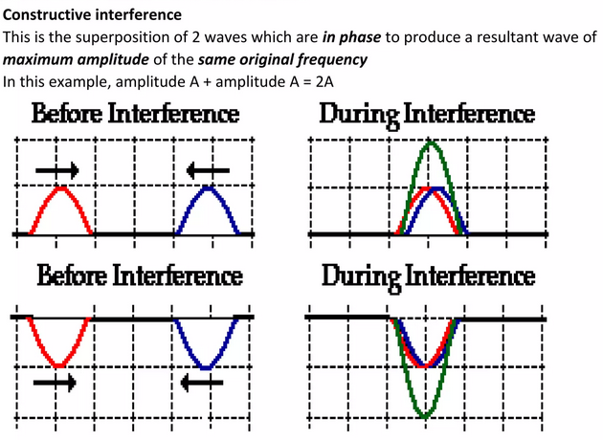
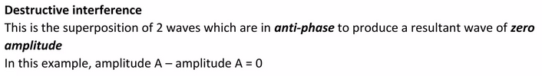
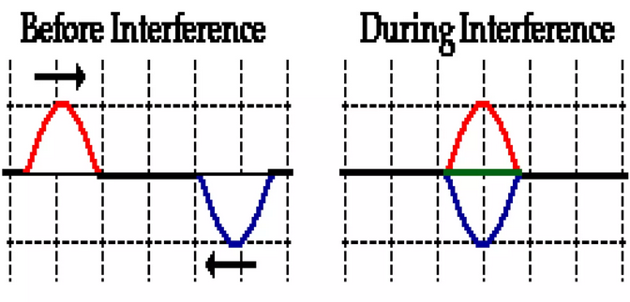
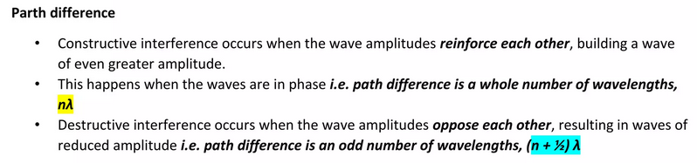
Principle of Superposition
Part II begins: when two waves share the same medium

Slide 19

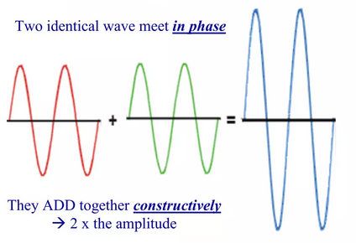
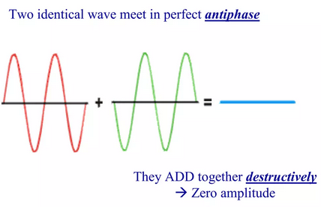
Interference of Waves — 3 Cases
When two same-wavelength waves travel the same direction
y'ₘ = 2yₘ · cos(φ/2)
Fully Constructive
Fully Destructive
Intermediate
φ = π (or 3π, 5π, …)
φ = 0 (or 2π, 4π, …)
0 < φ < π
y'ₘ = 2yₘ
y'ₘ = 0
0 < y'ₘ < 2yₘ
Partial alignment. Amplitude between zero and maximum. Most common case.
Peaks align with peaks. cos(0)=1. Maximum possible amplitude. In phase.
Peaks align with troughs. cos(π/2)=0. Complete cancellation. String flat.
Key: integer multiples of 2π (whole wavelengths) can always be discarded — only the fractional part determines the interference type.

Slide 20
General Interference — Arbitrary Phase Difference
Two identical waves with a phase difference φ:
y_R = 2A cos(φ/2) · sin(kx − ωt + φ/2)
Phase Difference φ | Result | Amplitude | Type
φ = 0, 2π, 4π | cos(φ/2) = 1 | 2A (maximum) | Constructive
φ = π, 3π, 5π | cos(φ/2) = 0 | 0 (minimum) | Destructive
0 < φ < π | 0 < cos(φ/2) < 1 | Between 0 and 2A | Partial
Note: Waves that obey superposition are called LINEAR waves. Ocean waves are NON-LINEAR — superposition does not perfectly apply.

Slide 21
Section 4
Standing Waves & Resonance

Slide 22
Standing Waves — How They Form
Standing waves form when two identical waves travel in opposite directions and interfere continuously.
y(x,t) = 2A sin(kx) · cos(ωt)
This is NOT a travelling wave — it's a product of a spatial function and a time function.
● Node: zero displacement (always zero)
◆ Antinode: maximum displacement
Nodes: x = nλ/2 (n = 0, 1, 2, …)
Antinodes: x = (2n+1)λ/4

Slide 23
Normal Modes — Harmonics on a Fixed String
A string fixed at both ends supports standing waves only at discrete frequencies:
Allowed Wavelengths
Natural Frequencies
λₙ = 2L/n (n = 1, 2, 3 …)
fₙ = nv/2L = n · f₁
L = string length
f₁ = fundamental frequency
n = 1
1st Harmonic
(Fundamental)
n = 2
2nd Harmonic
(1st Overtone)
n = 3
3rd Harmonic
(2nd Overtone)

Slide 24
Worked Example — Standing Waves on a String
Problem (Halliday Example 16.7)
A 2.00-m string has linear density μ = 0.006 kg/m. A 2.00-kg mass provides tension. Find: (a) wave speed, (b) wavelengths of first 3 modes, (c) frequencies of first 3 modes.
(a) Wave speed:
v = √(F_T/μ) = √(mg/μ) = √(2.00 × 9.8 / 0.006) = √(3267) = 57.15 m/s
(b & c) Modes:
Mode n | λₙ = 2L/n | fₙ = v/λₙ
n = 1 (Fundamental) | λ₁ = 2×2.00/1 = 4.00 m | f₁ = 57.15/4.00 = 14.29 Hz
n = 2 (2nd Harmonic) | λ₂ = 2×2.00/2 = 2.00 m | f₂ = 57.15/2.00 = 28.58 Hz
n = 3 (3rd Harmonic) | λ₃ = 2×2.00/3 = 1.33 m | f₃ = 57.15/1.33 = 42.87 Hz

Slide 25
Practice Problems — Lecture 6
P1
P2
A wave y = 0.4 sin(3x − 6t) (SI). Find A, λ, f, T, and direction.
A string (μ = 0.0075 kg/m) is under 300 N tension. Find wave speed.
Answer: v = √(300/0.0075) = √40000 = 200 m/s
Answer: A=0.4m, k=3, ω=6 → λ=2.09m, f=0.955Hz, T=1.047s, →+x
P3
P4
Two sound waves: same A & λ, phase shift π/2. What is the resultant amplitude?
A 1.5-m guitar string resonates at fundamental. Wave speed = 300 m/s. Find f₁, f₂, f₃.
Answer: y_R = 2A cos(π/4) = 2A × 0.707 = 1.414A
Answer: f₁=100Hz, f₂=200Hz, f₃=300Hz (fₙ = nv/2L)

Slide 26
Key Equations — Lecture 6 Reference Sheet
Wave Speed
Wave Speed on String
Wave Function (+x)
v = fλ = λ/T
v = √(F_T / μ)
y = A sin(kx − ωt + φ)
Wave Number
Angular Frequency
Superposition
k = 2π/λ
ω = 2πf = 2π/T
y_R = y₁ + y₂ + …
Resultant Amplitude
Standing Wave
Harmonics (String)
y_R = 2A cos(φ/2) sin(kx−ωt+φ/2)
y = 2A sin(kx) cos(ωt)
fₙ = nv/2L = n·f₁

Slide 27
Lecture 6 Summary
⚡
Wave Speed: v = fλ — connects spatial and temporal properties of any wave.
🎸
String Speed: v = √(F_T/μ) — controlled by tension and mass per unit length.
📐
Wave Function: y = A sin(kx − ωt + φ) — full mathematical description.
+
Superposition: Total displacement = algebraic sum of all individual waves.
✅
Constructive: Waves in phase → amplitude doubles. Δφ = 0, 2π, 4π, …
❌
Destructive: Waves 180° out of phase → amplitude = zero. Δφ = π, 3π, …
🎵
Standing Waves: Fixed nodes, oscillating antinodes, resonance at fₙ = nf₁.

